Slide 1
NumPy
Infographics – Understanding NumPy better, faster

Slide 2






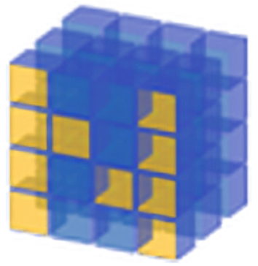






Evolution of Array Computing in Python
?
Numeric
1995
2003
2006
2008
2012
2015
Today

Slide 3
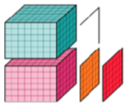
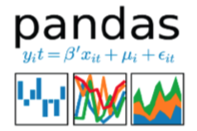



Python: Current state of n-dimensional arrays
Implementors
Consumers

Slide 4
“NumPy’s” vision for interoperable array libraries
Implementors
NumPy High-level APIs
Consumers

Slide 5


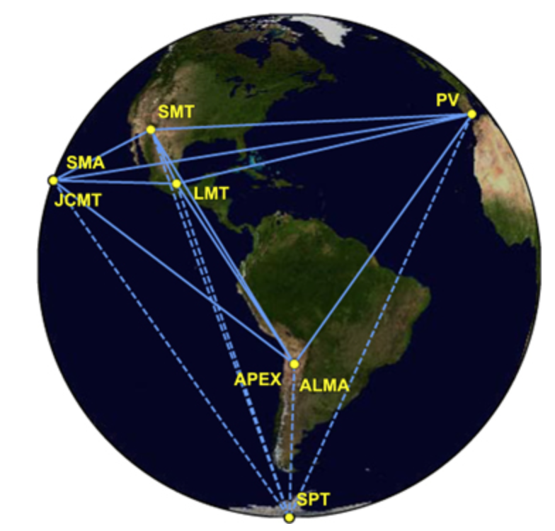
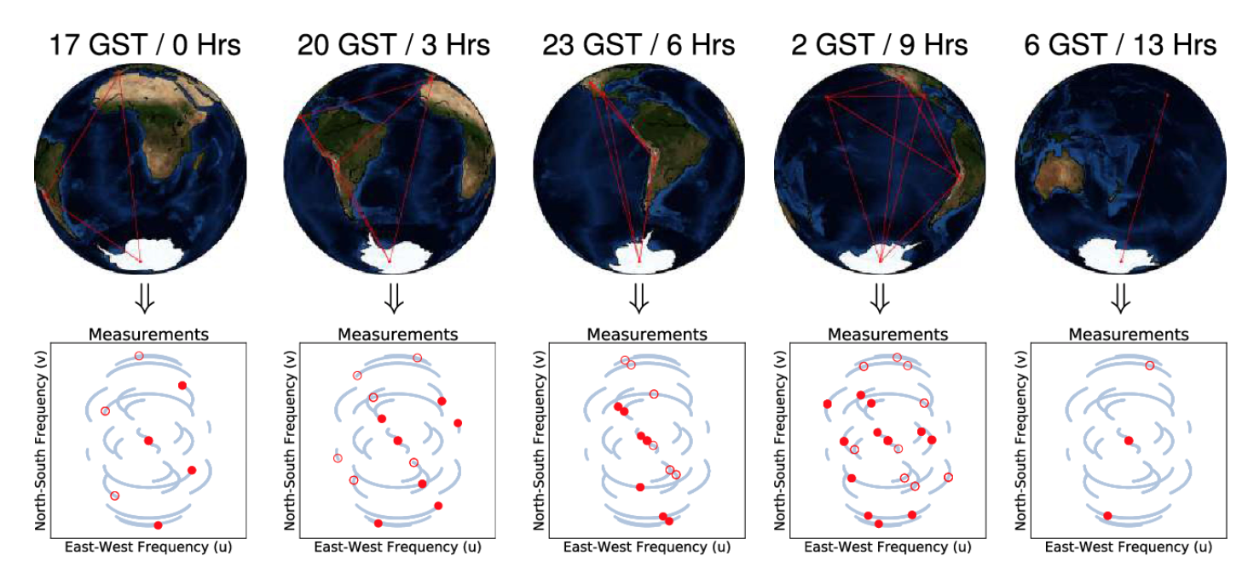
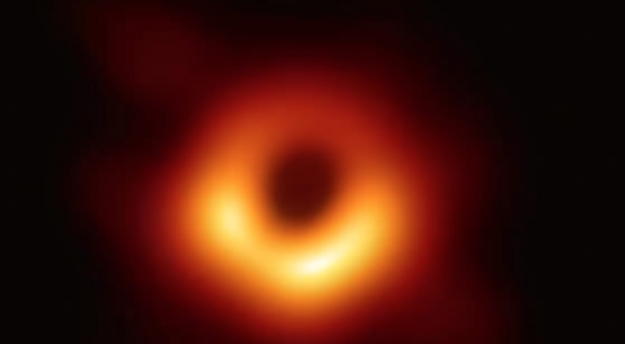
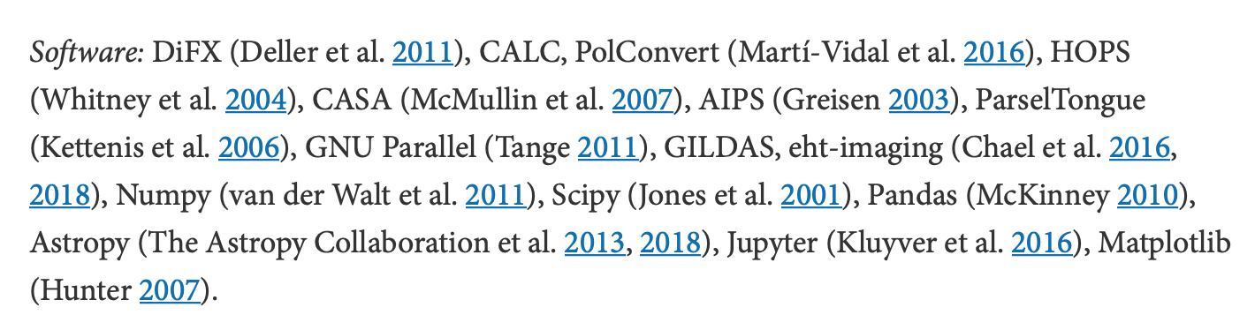
NumPy Showcase: Putting together images of a ‘black hole’
Data correlation, calibration, reduction pipelines
Event Horizon Telescope
Petabytes of data (measurements)
Scientific, Astrophysics & Computing Algorithms
Image analysis
https://github.com/achael/eht-imaging/
Imaging, analysis and simulation software for radio interferometry
NumPy was one of the software used!
M87 – the first image of a black hole
Notes:
Paper reference https://iopscience.iop.org/article/10.3847/2041-8213/ab0c57/meta
Image source https://becominghuman.ai/step-by-step-black-hole-image-86b79377176e
https://aasnova.org/2018/09/24/planning-for-images-of-a-black-hole/
https://www.youtube.com/watch?v=xAbJkn4uRL4

Slide 6
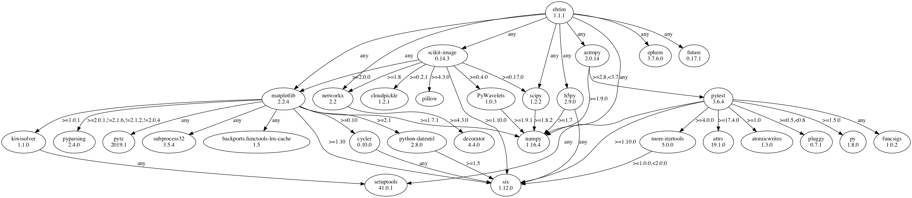
Black Hole study: eht_imaging dependency graph highlights NumPy

Slide 7
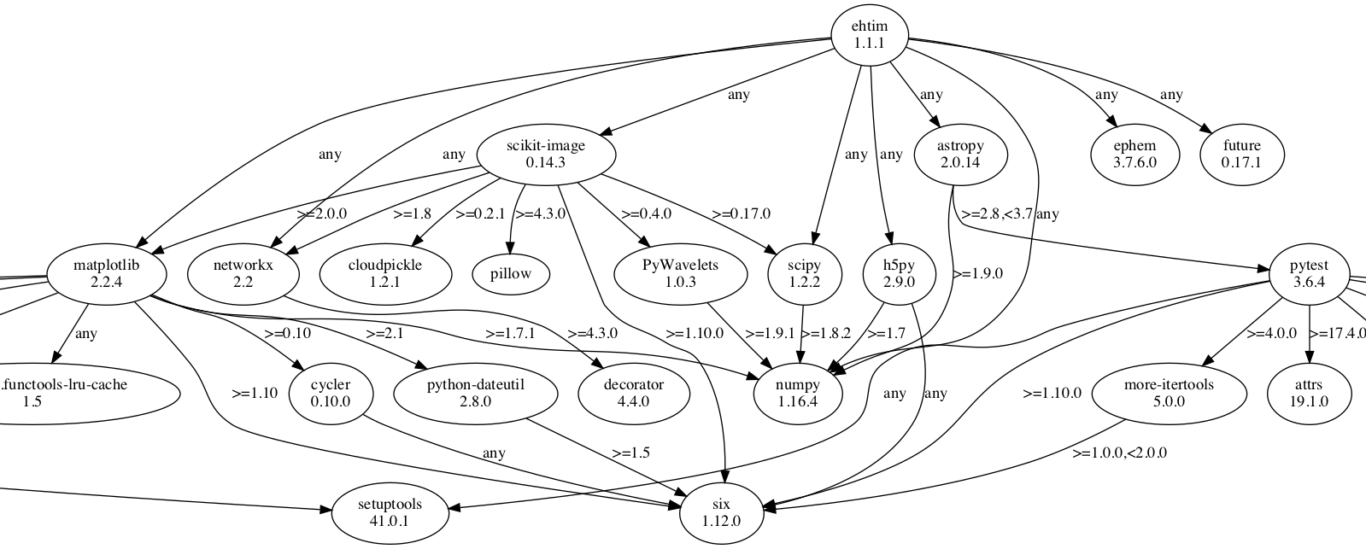

Slide 8

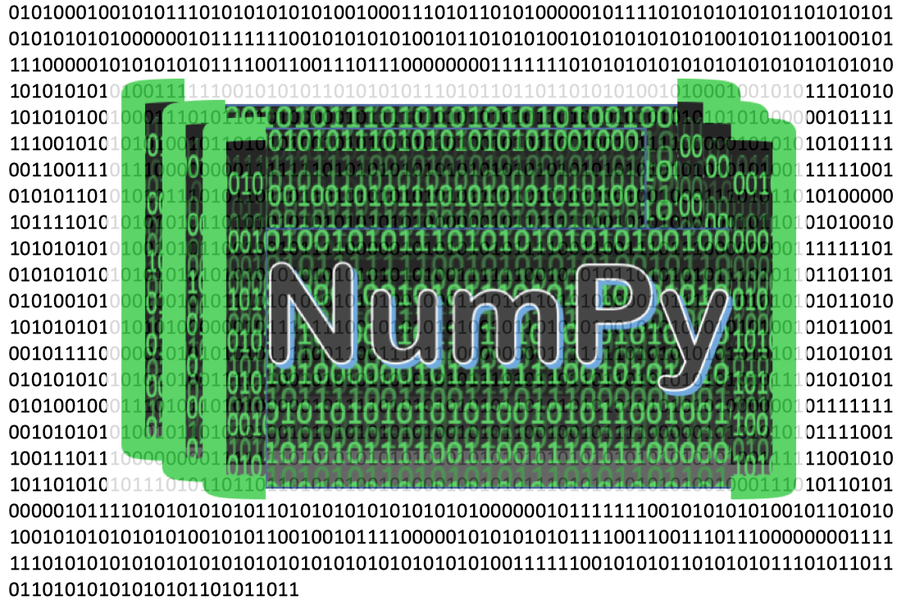
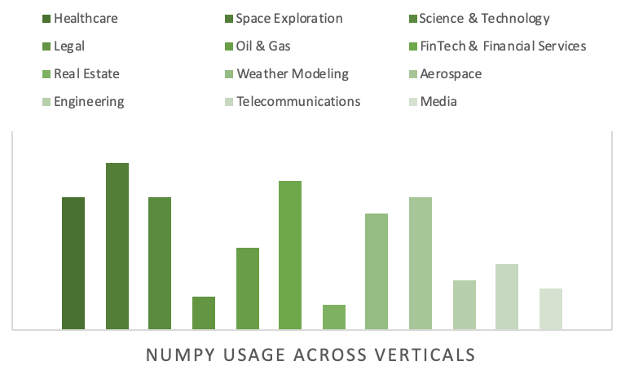





24
Downloads
million
(last month, 2019)
Deep Learning (AI/ML)
10 – 15
Digital Signal Processing
million
Users Worldwide
Data Science
What is NumPy used for?
$
1.3
million
Lifetime Funding since
Gene Sequencing, Bioinformatics
NLP, Text Processing
~10
Image,
Audio & Video processing
devs
Active Maintainers
Notes:
Companies that use NumPy https://discovery.hgdata.com/product/numpy

Slide 9
Industries powered by NumPy
24
FinTech
Downloads
million
(last month, 2019)
Weather Modelling & Simulation
Media
10 – 15
?
Telecom
Science
&
Technology
million
Aerospace
?
Users Worldwide
Space
Exploration
Real
Estate
Legal
$
1.3
Oil & Gas
Healthcare
million
Engineering
Lifetime Funding since
Data Science
Image Processing
Other Use Cases
Deep Learning
Audio & Video Processing
Gene Sequencing
~10
NLP, Text
Processing
What is NumPy used for?
devs
Active Maintainers
Notes:
Companies that use NumPy https://discovery.hgdata.com/product/numpy

Slide 10
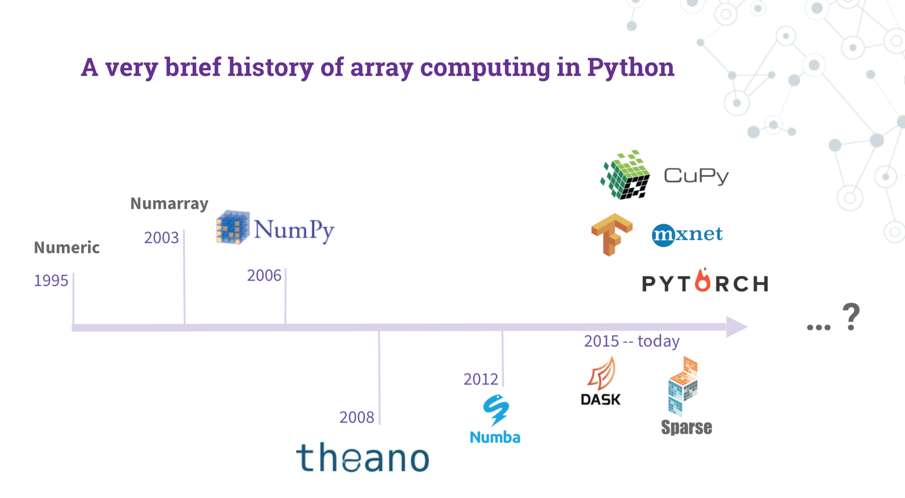
BEFORE

Slide 11
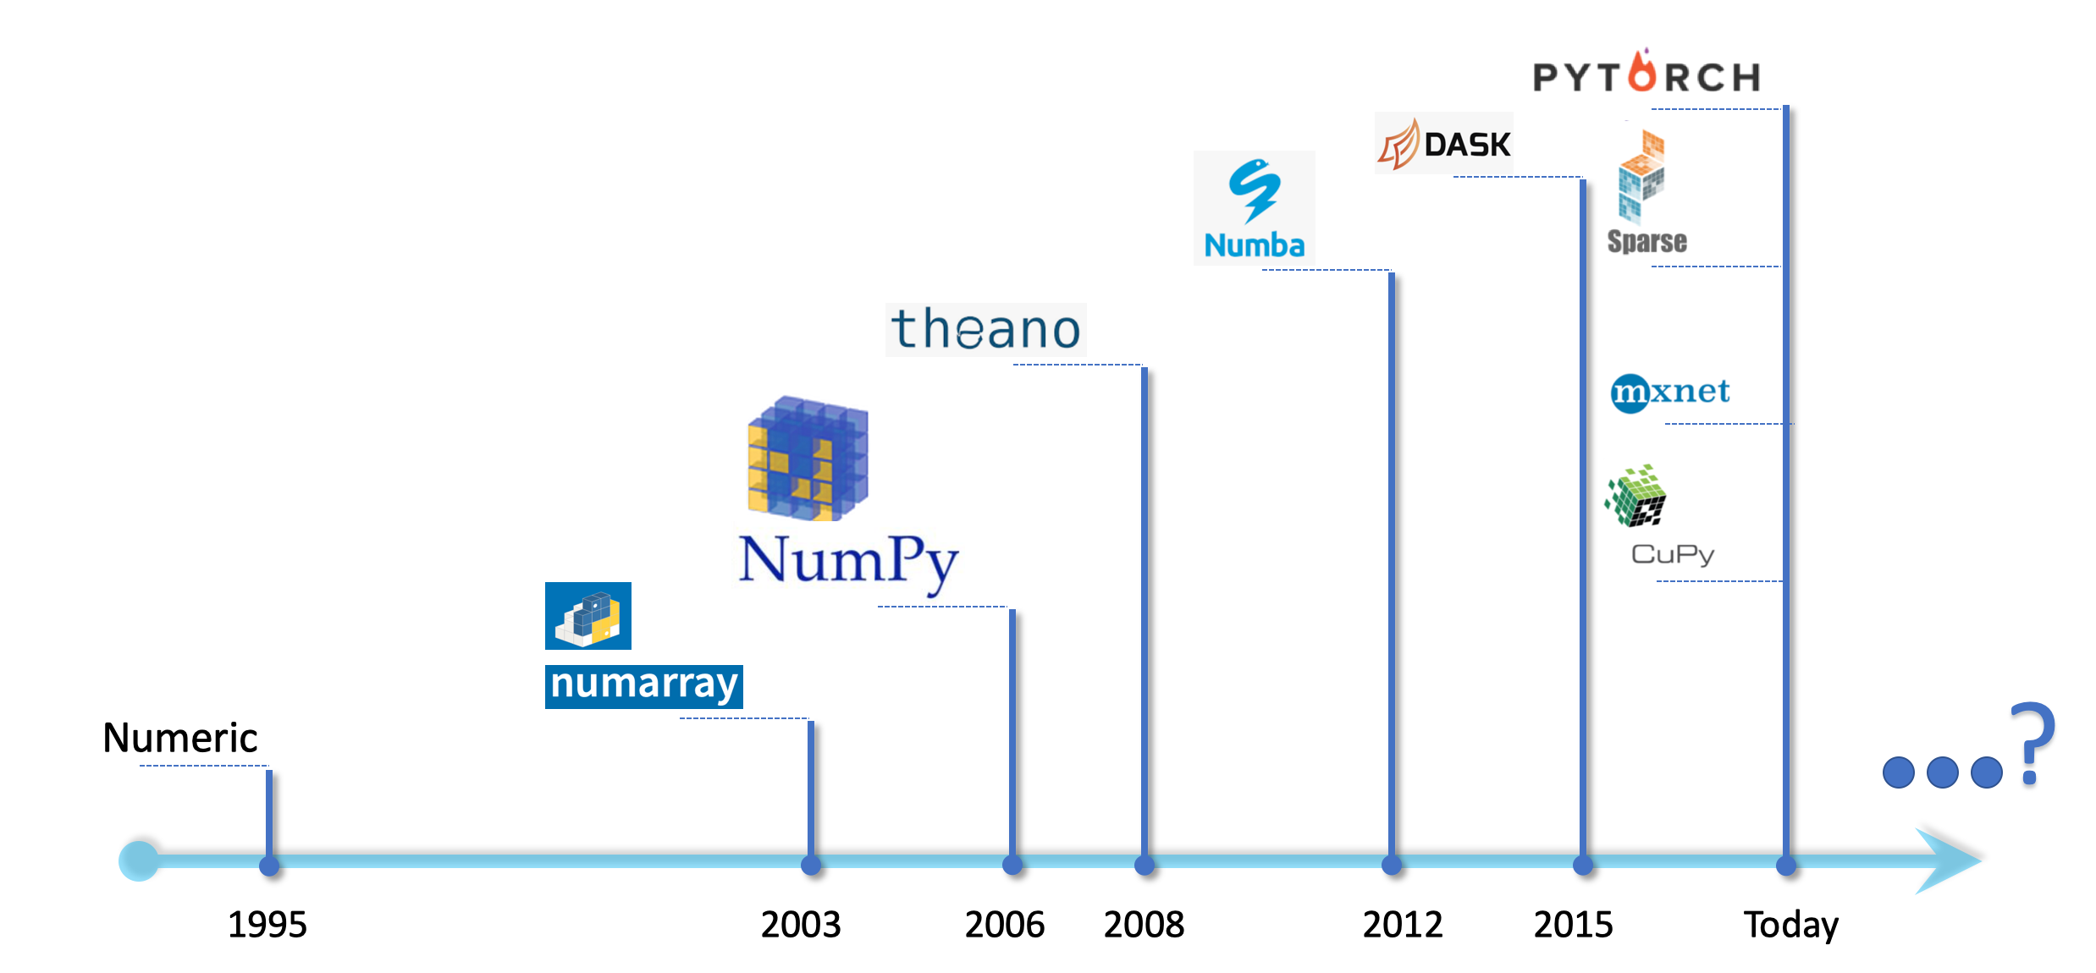
Array Computing Landscape
AFTER

Slide 12

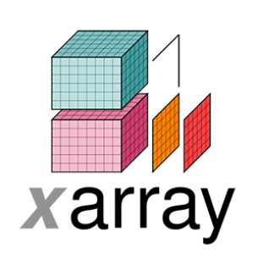


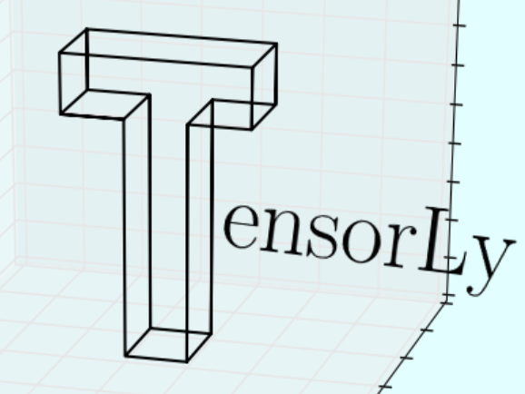





Mature
Emerging
Launch Year
2006
2008
2012
2014
2015
2016
2017
2018
2019

Slide 13
2D Array
N-Dimensional Array
GPU Support
CPU
Only

Slide 14






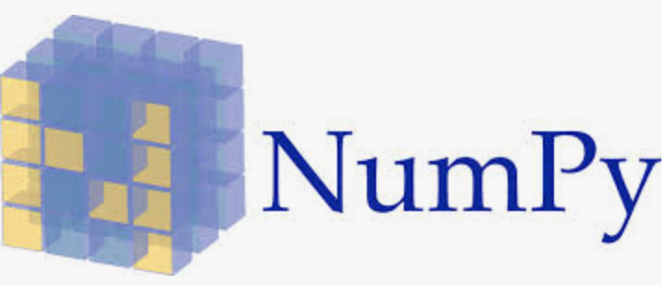









Extract, Transform, Load (ETL)
Data Exploration
Python Libraries for Data Science
Data Evaluation
Data Modeling
Data Presentation

Slide 15
Data Science
Algorithms
Machine Learning
Mathematics
Computer Science
Data Science
Statistical Analysis
Data Processing
Scientific Methodology
Data Modeling
Domain Expertise

Slide 16
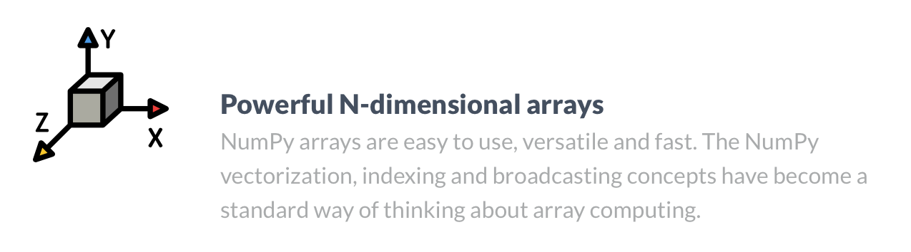

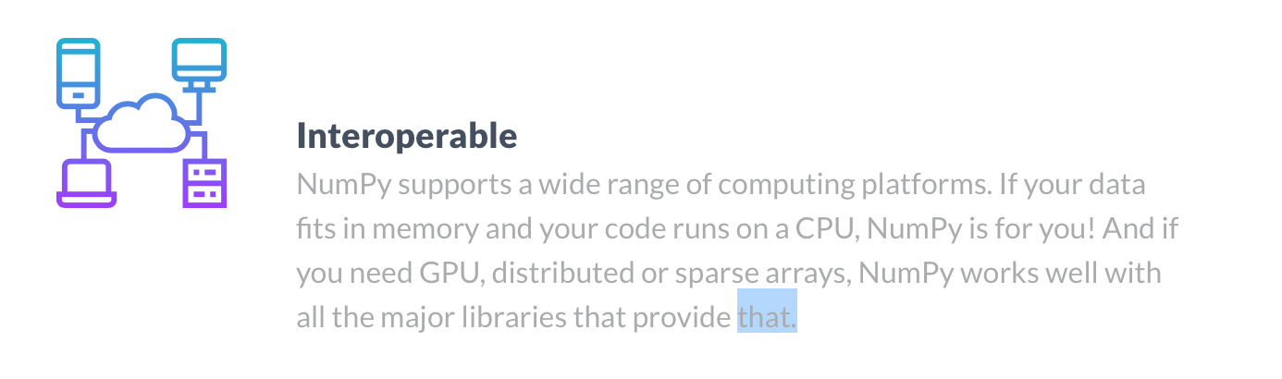
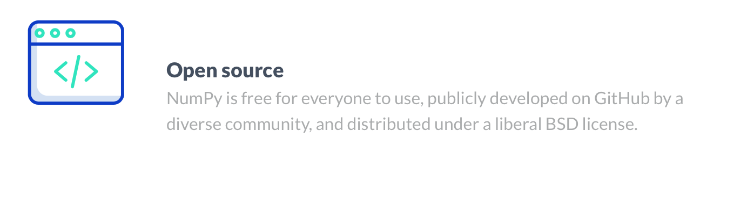
Copy Improvisations
Before
After
Fast, versatile and easy to use
NumPy vectorization, indexing and broadcasting concepts are the de-facto standards of array computing today.
Fundamental package for scientific computing
NumPy offers comprehensive mathematical functions, random number generators, linear algebra routines, Fourier transforms and more.
Works on your choice of computing platform
NumPy supports a wide range of computing platforms and works well with all major libraries that provide distributed or sparse arrays. Whether your code fits in memory and runs happily on a CPU or if you need a GPU to run your code, NumPy is for you!
Free for everyone to use
Distributed under a liberal BSD license, NumPy is publicly developed and maintained on GitHub by an enthusiastic, active and diverse community.

Slide 17
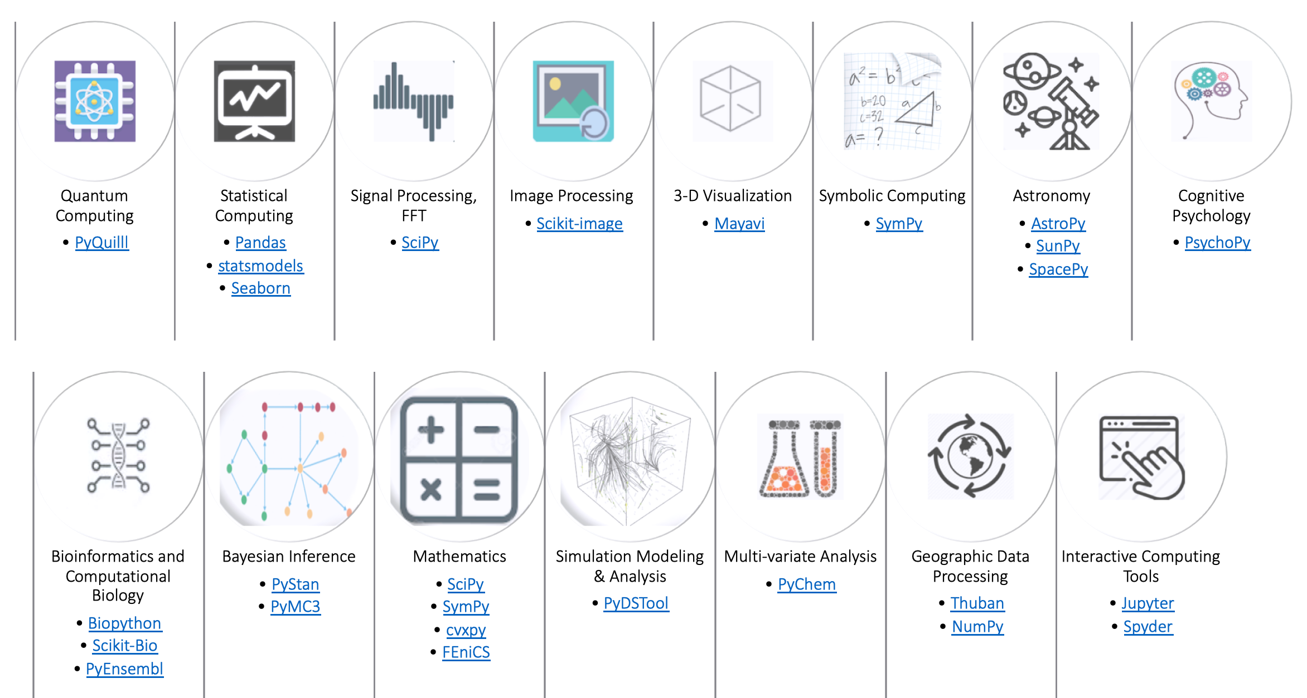
Notes:
This slide was lost due to powerpoint deck corruption. Too large in size and disk encryption is causing some issues. Thank God for Time Machine, restored the copy from yesterday but lost the actual picture – thankfully I had taken a screenshot.

Slide 18
NumPy Case Studies
First image of a Black Hole
Detection of Gravitational Waves
Sports Analytics
Self Driven cars
Image Credits: NASA
Image Credits: LIGO
Image Credits: Kaggle/Venky
Image Credits: Medium/Yogeshojha

Slide 19
M87 Black hole key NumPy capabilities
Scale
Data volumes involved in EHT were ~350 Terabytes per day
Complexity
Data correlation from 8 telescopes located across the globe with recorded data synchronization using atomic clocks
Speed
Fast analysis capability to quickly image, manipulate datasets with newer corrections, insights gained during dataset reductions and processing phases.

Slide 20
GW Key NumPy Capabilities utilized
Data volumes involved in EHT imaging were of the order of ~350 Terabytes per day!
Complexity
Data correlation from 8 telescopes located across the globe with recorded data synchronization using atomic clocks
Speed
Fast analysis capability to quickly image, manipulate datasets with newer corrections, insights gained during dataset reductions and processing phases
Scale

Slide 21
GW Key NumPy Capabilities utilized
The observational Data volumes involved in LIGO Gravitational Wave project were of the order of Terabytes per day which is a huge computational challenge that NumPy addressed .
Complexity
Numerical relativity computations are fairly complex and figuring out Gravitational Wave signature is like finding a needle in a haystack
Agility
Visualization requires fast number crunching in order to present data visually such that scientists can make sense out of millions of numbers!
Scale

Slide 22
Cricket Key NumPy Capabilities utilized
Speed and agility of data analysis is of essence in Cricket, especially real time game analytics that involve cricket statistics, decision points and outcome prediction.
Numerical Analysis
Predictive Analytics requires complex numerical compute using cricket datasets, combined with real-time game observations, player fitness and game strategies.
Speed

Slide 23


Color palette (new)
PRIMARY COLORS #ffc553 #4dabcf #4d77cf
SECONDARY COLORS #ffffff #013243 #eeeeee #6c7a89

